Slide 1
Event Sourcing
& CQRS
Eric Swann – Account Opening

Slide 2

Two Great Tastes
Event Sourcing and CQRS
Totally separate
Don’t have to be used together
But…they are a natural fit
Notes:
One column layout with bullets, you may turn bullets off as well.

Slide 3
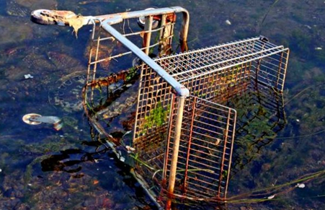
Case Study: The shopping cart
C# / .Net Core
Cars (CQRS/Event Sourcing)
Mongo
Vue.js / Quasar
Visual Studio Code
Linux (Ubuntu)

Slide 4
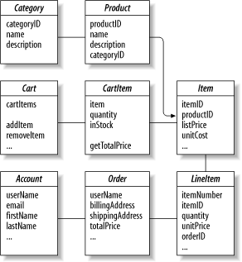
The CRUD Approach
A snapshot of current state is stored
You have one or more rows or documents
You may have “data objects”
You might use an ORM or document store
Often this is OK!
Notes:
One column layout with bullets, you may turn bullets off as well.

Slide 5
What happens when…
A shopper removes a cart item
Do you just delete it?
Is it ok to destroy that data?
Could that data have been useful?
You “soft deleted” it?
How did it come to be in that state?
Did the user remove it? The system?
Notes:
One column layout with bullets, you may turn bullets off as well.

Slide 6
And then…
Stakeholders want a new report
The cart item quantity was changed 5 times
Did you store that somewhere?
Do you have some really complicated audit log?
Can that log be transformed to a report model?
Approach needs to start from app inception
Notes:
One column layout with bullets, you may turn bullets off as well.

Slide 7
Event Sourcing
to the Rescue

Slide 8
Event Sourcing
You record domain events
You don’t store current state of an object *
Replay event streams to restore state
Built in audit log
Temporal and behavioral
Partners well with CQRS (Eventing)
Notes:
One column layout with bullets, you may turn bullets off as well.

Slide 9
CQRS
CQRS – Command Query Responsibility Separation
Allows scaling of command and read sides separately
Allows usage of optimal technologies
Kafka
Elastic
Cassandra
Etc…

Slide 10
Workshop:
Event Sourced Cart

Slide 11
Issues

Slide 12
Not a silver bullet
Defining the domain model and events
Tedious
Requires analysis and potential refactoring
Much more complex to build and deploy
Versioning…have to version events or add new events
System must retain backwards compatibility
Do you migrate events? How?
Notes:
One column layout with bullets, you may turn bullets off as well.

Slide 13
Questions?
Materials:
https://github.com/eric-swann-q2/DevCon2017
Cars (also on Nuget.org):
https://github.com/eswann/cars
Notes:
One column layout with bullets, you may turn bullets off as well.

